Slide 1
Financial Risk Assessment
Team : John Mitton, Kamran Madatov, Bao Thai
Mentor: Dr. Ted Ahn, Dr. Goldwasser

Slide 2

General Overview
Project Goal
What is Risk Assessment
Application
Current Timeline and Future Planning
Functional Accomplishments
Monte Carlo (Concept, Process, Results and Analysis)
Sentiment Scoring (Concept, Process, Results and Analysis)
Improvements
Project Overview
Project Overview → Monte Carlo → Webcrawler → Results and Improvement

Slide 3
Our Goal
The objective of this project is to help investors make appropriate decisions with their portfolio to reduce loss when holding, buying, and selling investments.
A mobile application will be created to track listed investments and inform the user based on news, history of stock prices, trend volume, social media, and market stock exchange.
By using statistical data and probability calculation, we would like to ensure accuracy of estimates and allow users to be more informed on changes with a stock.
Project Overview → Monte Carlo → Webcrawler → Results and Improvement

Slide 4
Financial Risk Assessment
To estimate and predict changes with particular investments due to statistical data or news information that would be essential to the outcome of investments
Variable at Risk
Statistical method to measure and quantify level of risk of particular investment opportunities
Project Overview → Monte Carlo → Webcrawler → Results and Improvement

Slide 5
VaR Application
Determine the probability and rate of a stock’s growth for a certain time period
Manage an aggregation of portfolio performance for an investment firm
Can also be applied across different markets besides stocks (real estates, etc.)
Project Overview → Monte Carlo → Webcrawler → Results and Improvement

Slide 6
Functional Accomplishment (1st Sem)
Monte Carlo Simulation
Using Historical Data
Web Crawler
Article Parsings (Bloomberg, Motley Fool, etc)
Sentiment Score
Loughran Mcdonald Dictionary
Project Overview → Monte Carlo → Webcrawler → Results and Improvement
Notes:
Add a slide about what was worked on in this semester
Add timeline

Slide 7
Monte Carlo Simulation
Generate random samples that follow the problem constraints
Find the mean of the samples
This mean can be used to predict values and determine risks
Project Overview → Monte Carlo → Webcrawler → Results and Improvement

Slide 8
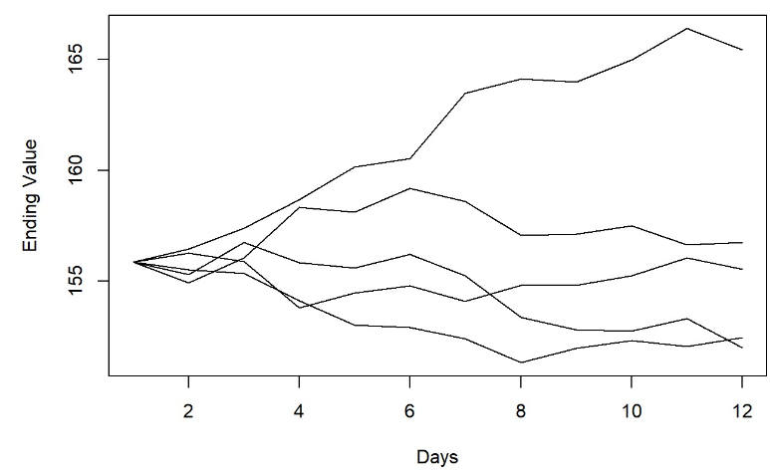
Monte Carlo Simulation Model
Project Overview → Monte Carlo → Webcrawler → Results and Improvement

Slide 9
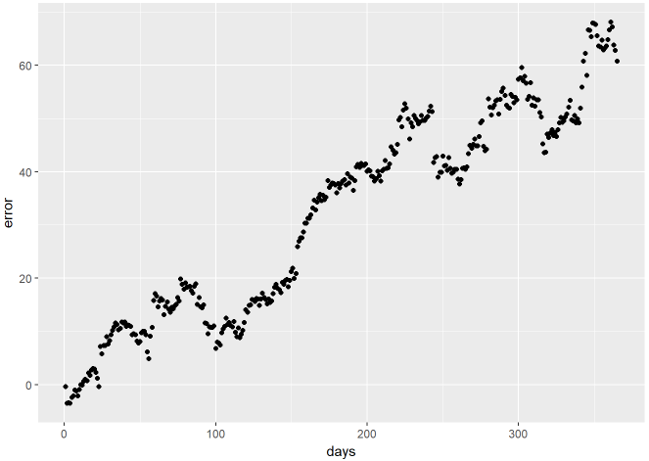
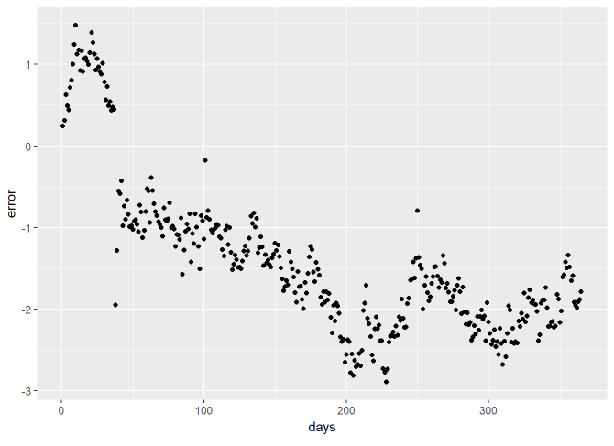
Monte Carlo Simulation Testing
Amount of error over one year of tested data using ten years worth of historical data.
Project Overview → Monte Carlo → Webcrawler → Results and Improvement

Slide 10
Monte Carlo Simulation Accuracy
Most accurate to one week
Error Values for 1 week: AAPL: -2.3 CNC: -0.34 JNP: 0.52 TSLA: 14.9
Simulating for a year produces large mean error
Error Values for 1 year: AAPL: 31.9 CNC: 0.71 JNP: -1.4 TSLA: 64.5
Better on less volatile stocks
E.g. ones that do not rely on the next big thing
Project Overview → Monte Carlo → Webcrawler → Results and Improvement

Slide 11
Loughran McDonald Dictionary
The dictionary provides a means of determining which tokens (collections of characters) are actual words, which is important for consistency in word counts.
statistics for word frequencies in all 10-Ks from 1994-2014 (including 10-X variants)
85,000+ proper nouns and abbreviations (negative, positive, uncertainty, litigious, modal, constraining)
354 Positive
2329 Negative
Project Overview → Monte Carlo → Webcrawler → Results and Improvement

Slide 12
Sentiment Scoring
Parse through the article
Count total number of actual words (LM dictionary)
Count Number of positive of words and negative
% Positive Words = Total Positive Words / Total Actual Words
% Negative Words = Total Negative Words / Total Actual Words
Sentiment Score: %Positive - %Negative
Project Overview → Monte Carlo → Webcrawler → Results and Improvement

Slide 13
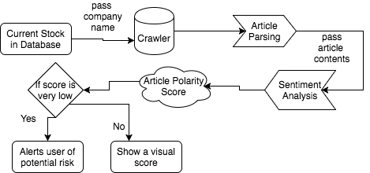
News Article Web Crawling - Process
Project Overview → Monte Carlo → Webcrawler → Results and Improvement

Slide 14
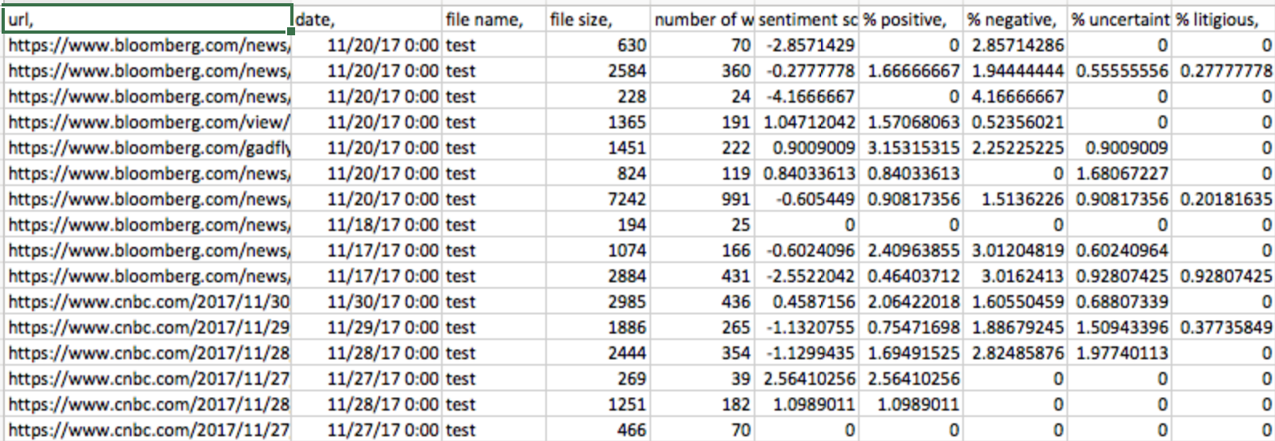
Webcrawler Result
Project Overview → Monte Carlo → Webcrawler → Results and Improvement

Slide 15
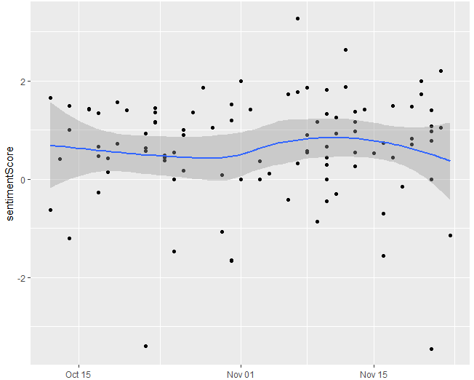
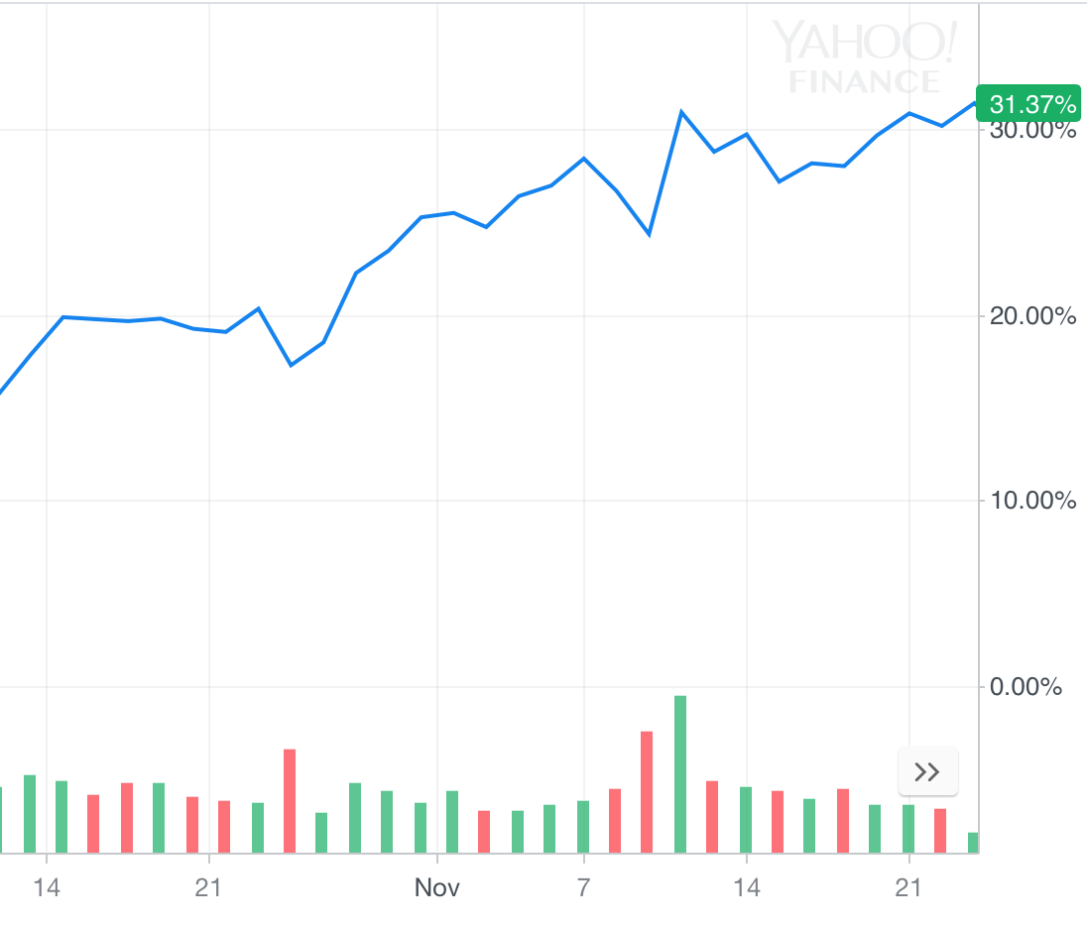
NVDA
Sentiment Score
Stock Price % Change
Project Overview → Monte Carlo → Webcrawler → Results and Improvement

Slide 16
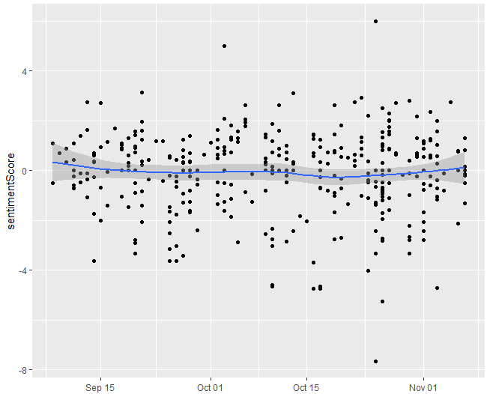
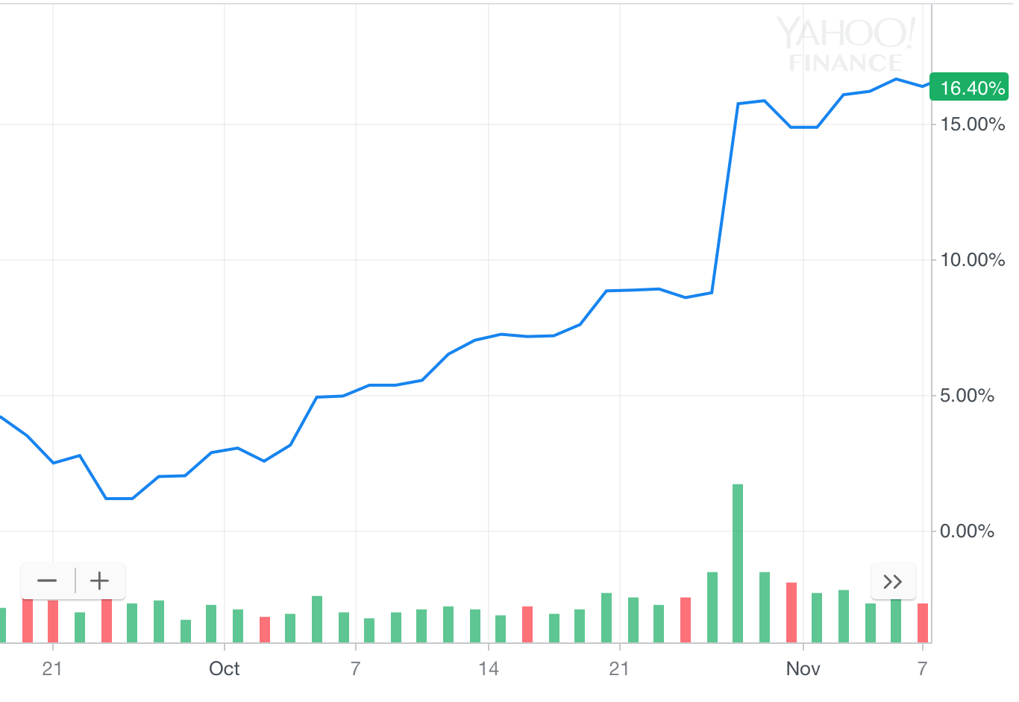
MSFT
Sentiment Score
Stock Price % Change
Project Overview → Monte Carlo → Webcrawler → Results and Improvement

Slide 17
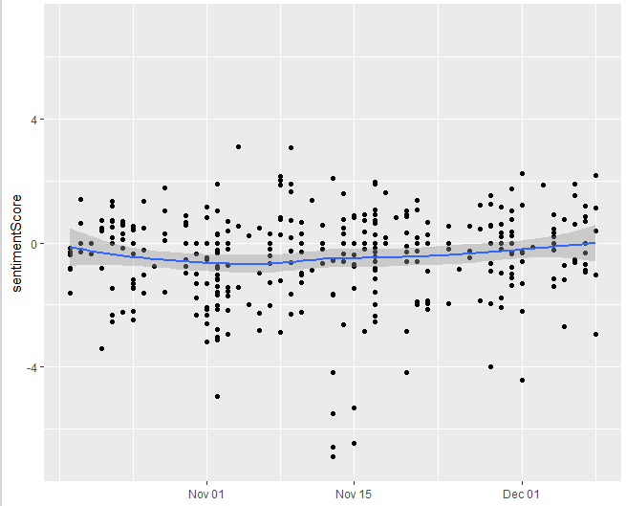
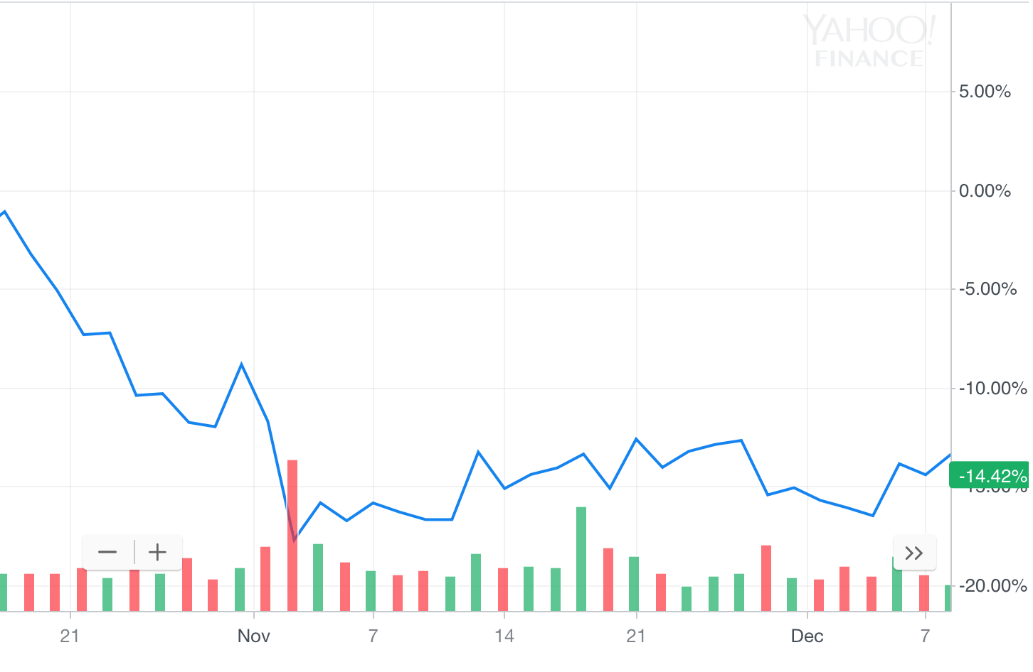
TSLA
Sentiment Score
Stock Price % Change
Project Overview → Monte Carlo → Webcrawler → Results and Improvement

Slide 18
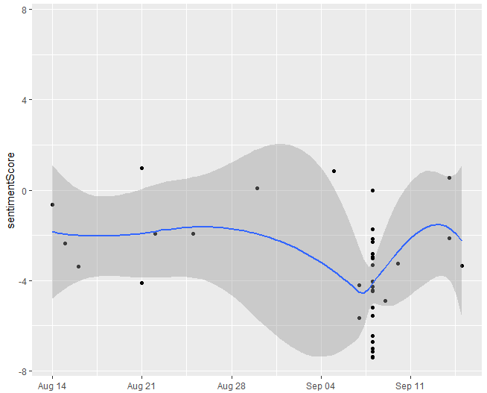
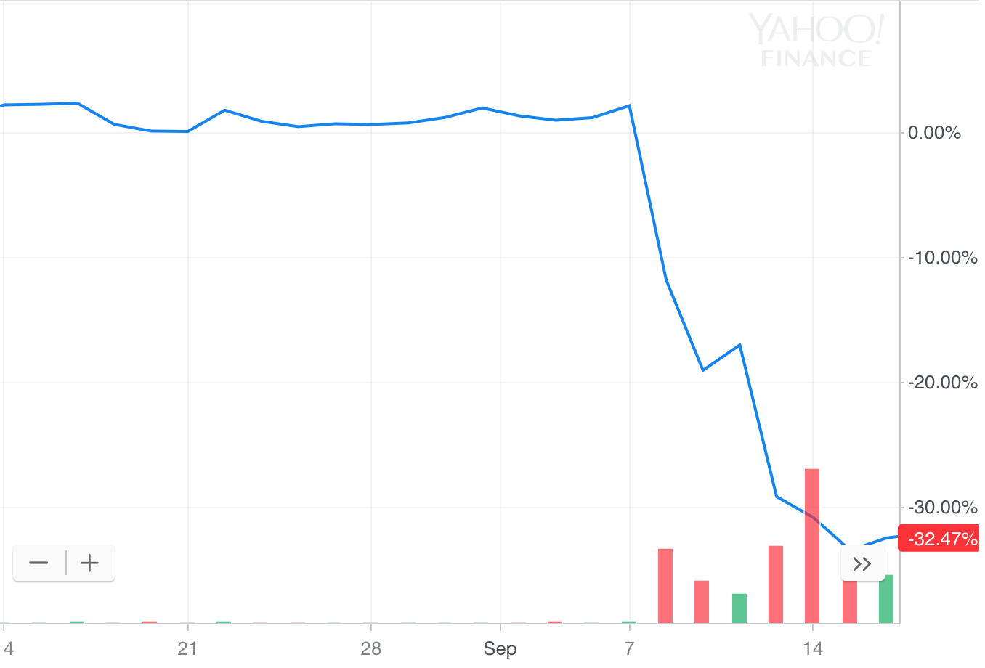
EFX
Sentiment Score
Stock Price % Change
Project Overview → Monte Carlo → Webcrawler → Results and Improvement

Slide 19
Interpretation
Depending on trend
Positive linear slope[1, >]
High risk
High chance for a short term growth (Short term long buys)
Near zero risk sentiment score (low risk) [-1, 1]
Stable in growth
Long term investment opportunity?
Negative linear slope [<, -1]
High risk
High chance stock continue decreases (good for shorting)
Results & Accuracy
Qualitative Analysis
Data correlates with interpretation
Sentiment score relates to risk by absolute displacement from 0
Project Overview → Monte Carlo → Webcrawler → Results and Improvement

Slide 20
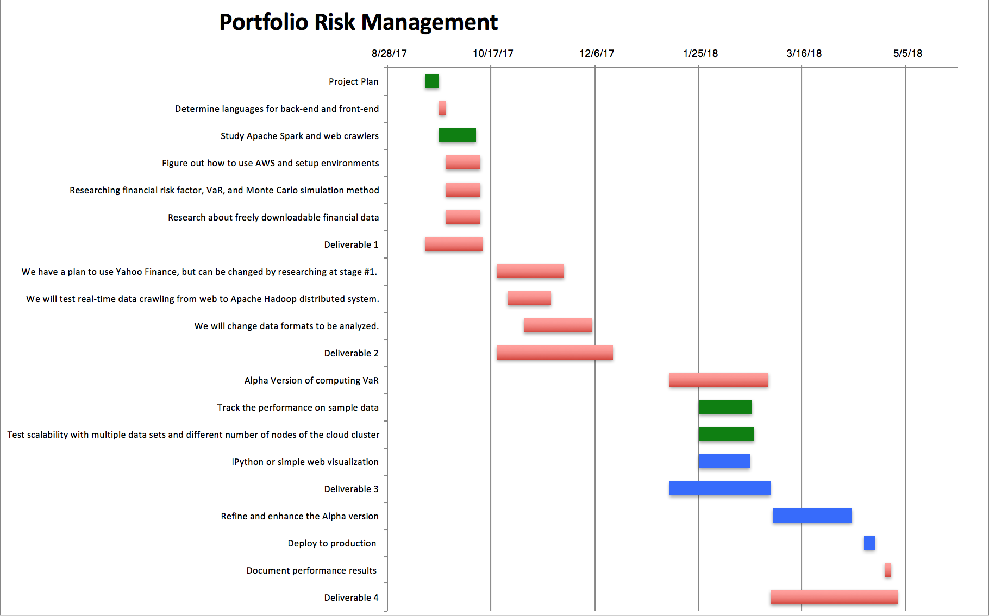
Timeline
1st Semester Goals
We are here

Slide 21
Improvement Opportunities
Crawler and Sentiment Scoring
Removing unrelated articles
More sources
Newer finance dictionary
Big Data Management (Hadoop) and Cluster Computation(Apache Spark)
Monte Carlo
Adapting the Monte Carlo model
Studying other versions
Neural Networks
Merging Sentiment Scoring and Monte Carlo
Project Overview → Monte Carlo → Webcrawler → Results and Improvement

Slide 22
Overview
The backend (monte carlo, webcrawler, and sentiment score) currently stands strong with minor needs of improvement
Moving forward, front end application will be designed to integrate the backend for user interface and interaction
Functionality of Monte Carlo: Long Term Analysis
Functionality of WebCrawler/Sentiment Scoring: Immediate Analysis
Goal: Combine Sentiment Scoring & Monte Carlo to improve accuracy of long term analysis
Project Overview → Monte Carlo → Webcrawler → Results and Improvement

